Slide 1
Comprehensive Digital Marketing Project Work On Noise
Team Details
K J JOSEPH JERIN (TEAM LEADER)
B JOSITH NAVEEN (TEAM MEMBER)
SANA TEJASWI (TEAM MEMBER)
SOMAYAJULA SURNARAYANA (TEAM MEMBER)
KAMMA SAI SREE ANEESHA (TEAM MEMBER)
KOTTANA MADHU (TEAM MEMBER)

Slide 2
Comprehensive Digital Marketing Project Work On Noise
Team Members
Acknowledgement
I am B JOSITH NAVEEN , as a Team Member I have done these following Work in this Project
1. Powerpoint Presentation
2. Keywords Research
3. On Page Optimization

Slide 3
Keywords Research
OBJECTIVES FOR KEYWORD RESEARCH :
TO INCREASE WEBSITE TRAFFIC:
As keyword research helps us know which key words are used by target
customer mostly, by this we can improve our website traffic.
TO IMPROVE ORGANIC SEARCH RANKING:
By Keyword Research we can know which key words are performing best, which high search volume and lower competition, so that we can optimize our website with those key words to improve organic search ranking.
TO REACH OUT MORE AUDIENCE:
Keyword research helps us find out which keys are god to target out prospective customers and so that we can use those keywords in our website's content.

Slide 4
Keywords Research
KEY INSIGHTS :
1. Targeted content creation: Keyword research helps identify the topics and questions that your target audience is searching for. By incorporating these keywords into your content strategy, you can create valuable, relevant content that meets the needs of your audience.
2. Enhanced user experience: Understanding user search intent through keyword research allows you to align your content with what users are looking for. This improves the overall user experience on your website, leading to increased engagement, longer visit durations, and lower bounce rates.
3. Competitive Advantage: By focusing on these untapped keywords, you can gain a competitive advantage and attract targeted traffic that your competitors are missing out on.

Slide 5
Keywords Research
OBJECTIVES FOR KEYWORD RESEARCH :
TO INCREASE WEBSITE TRAFFIC :
As keyword research helps us know which key words are used by
target customer mostly, by this we can improve our website traffic.
TO IMPROVE ORGANIC SEARCH RANKING :
By keyword research we can know which key words are performing best, which high search volume and lower competition, so that we can optimize our website with those key words to improve organic search ranking.
TO REACH OUT MORE AUDIENCE :
Keyword research helps us find out which keys are god to target out
prospective customers and so that we can use those keywords in our website's content.

Slide 6
Keywords Research
CHALLENGES FACED DURING KEYWORD RESEARCH AND ANALYSIS :
Limited data accuracy :
Keyword research tools provide estimates and data based on historical trends. It's essential to consider this potential limitation when conducting keyword analysis.
Highly competitive keywords :
Some keywords may have high search volume but also intense competition. Ranking for such keywords can be challenging, especially if your website or content is relatively new.

Slide 7
Keywords Research
PROCESS OF CONDUCTING KEYWORD RESEARCH:
Limited Data Accuracy:
Keyword research tools provide estimates and data based on historical trends. It's essential to consider this potential limitation when conducting keyword analysis.
Highly Competitive Keywords:
Some keywords may have high search volume but also intense competition. Ranking for such keywords can be challenging, especially if your website or content is relatively new.

Slide 8
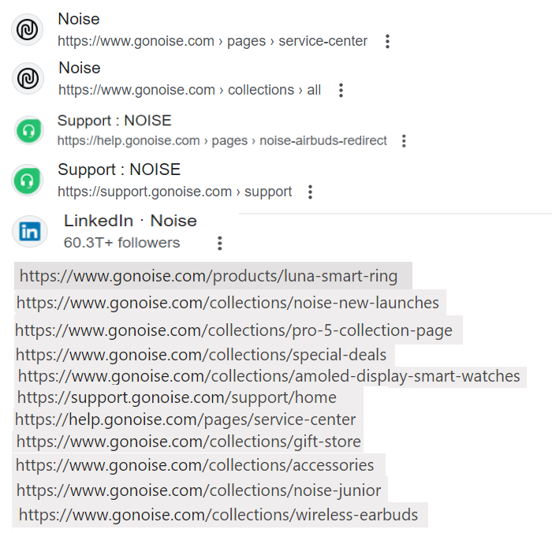
Keywords Research

Slide 9
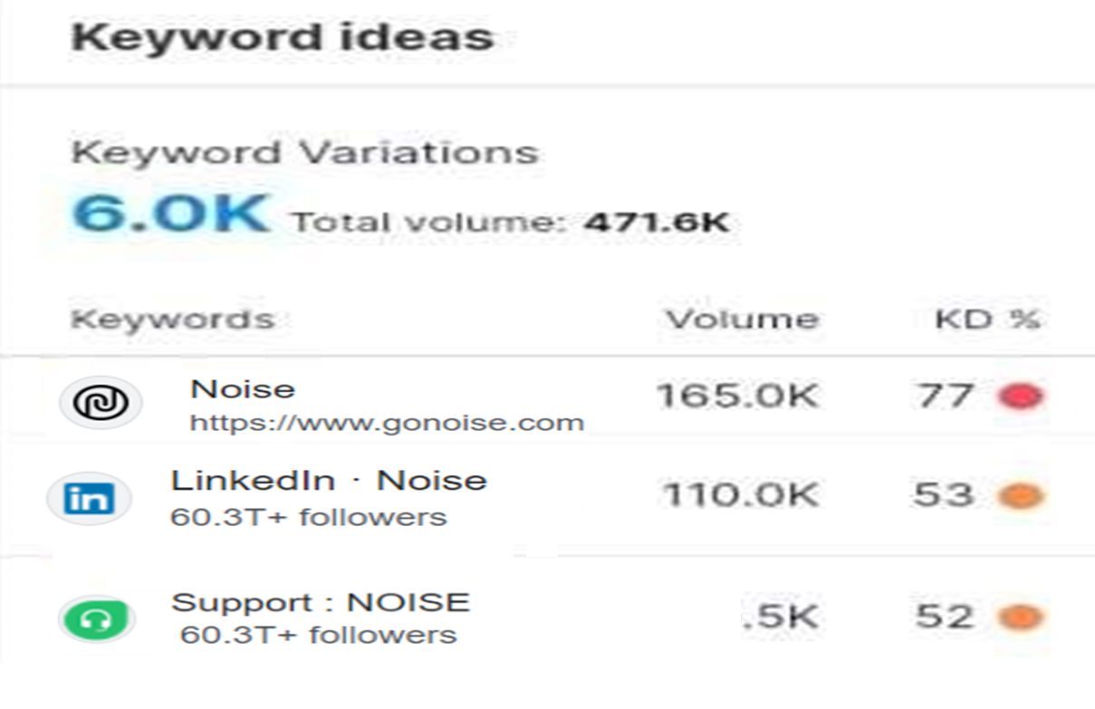
Keywords Ideas

Slide 10
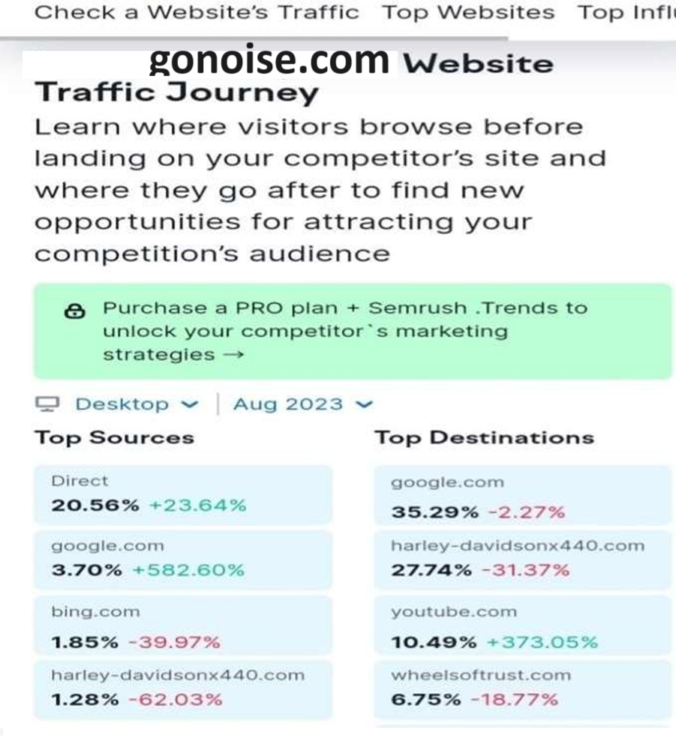
Website Traffic or On Page Optimization

Slide 11
Lessons Learned :
Consistency is Key: Consistency in content creation helps to establish brand recognition and build a loyal audience. Maintaining a consistent brand voice, visual identity, and posting schedule creates a cohesive brand experience for the audience.
Quality Over Quantity: While it's important to consistently create content, focusing on quality should take precedence over quantity. Well-produced and thoughtful content tends to have a more significant impact and can lead to higher engagement and brand loyalty.
Building Relationships and Collaborations: Collaboration with influencers, partners, or customers can provide fresh perspectives and expand the reach of the brand's content. Collaborations help tap into new audiences, bring in diverse ideas, and create engaging content.

